Slide 1
Métis
Madoka, Mizuho, Chisato

Slide 2
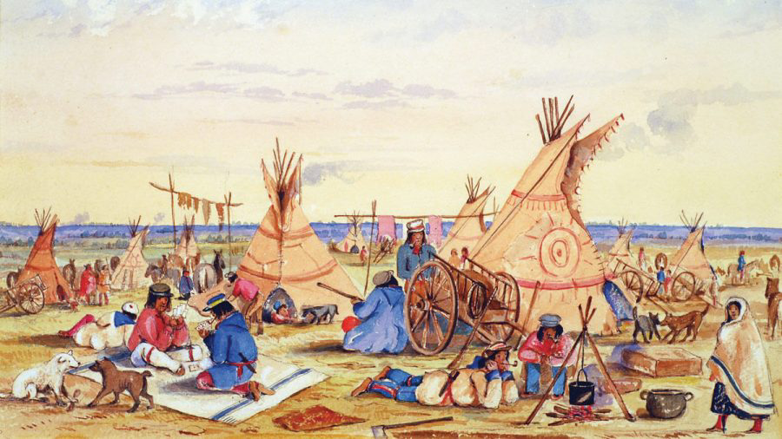
Introduction
Basic information
(population, area, flag, language, and life ways)
History
Arts, clothes, and dance.

Slide 3
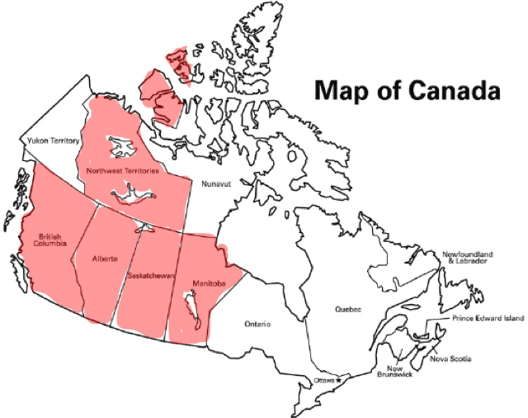
Basic information
Total population : 624,220 (in 2021)
Inhabit places : BC, Prairie Province ( Alberta, Saskatchewan, and Manitoba), Northwest Territories.

Slide 4
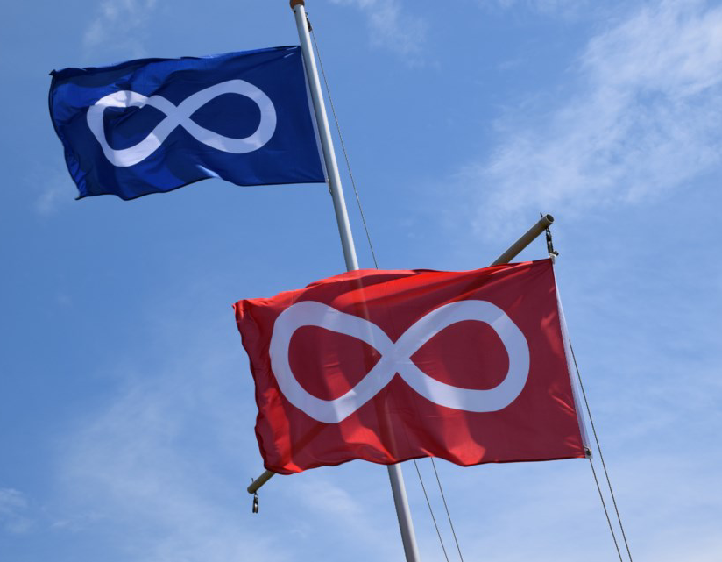
Métis flag
Symbol : infinity
→Métis culture Is forever
→European and First Nations.
Red and blue
→Red is French Métis, Blue is English Métis.

Slide 5
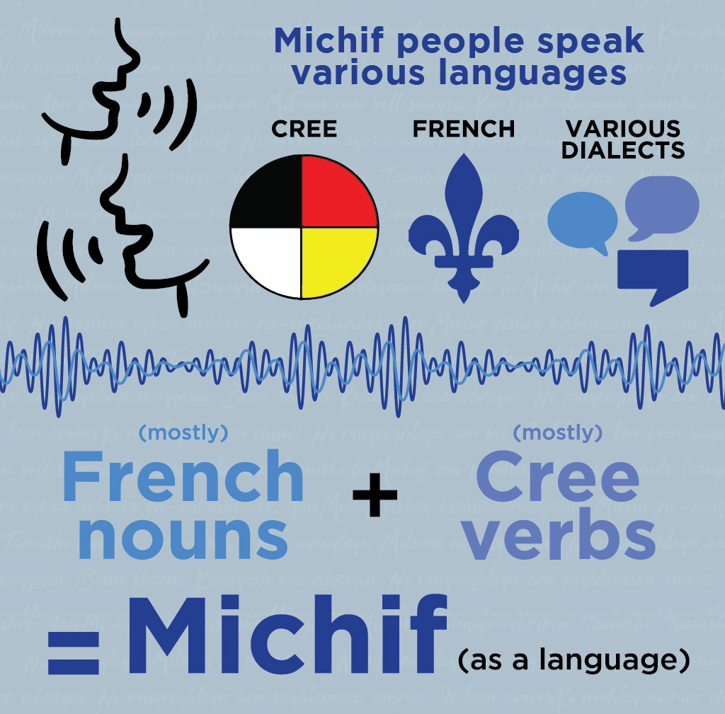
Métis language
They speak Michif.
It is composed of Cree verbs and French nouns.
Michif is still spoken.
Mainly, English and French are spoken now.

Slide 6
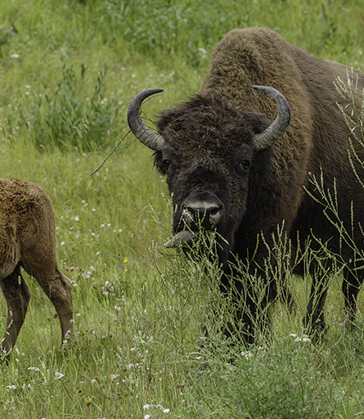
Life way
Adopting their lives to the season.
→ working in fields, hunting a bison, and collecting berries.
Bison pelts were sold and used in their clothing.
They believe resources are gifts from Creator.
→ They appreciate for it.

Slide 7
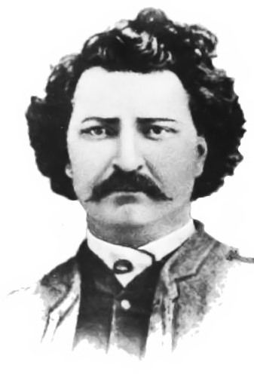
Louis Riel
Leader
Founded Manitoba
Red River Rebellion

Slide 8

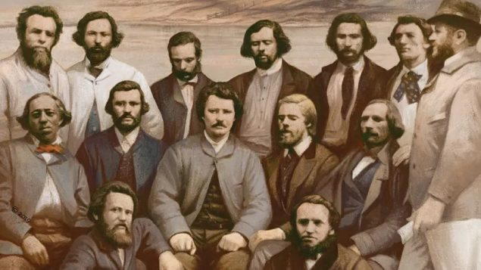

Red River Rebellion
Hudson’s Bay company and The Canadian government conflicted with Metis

Slide 9

Red River Rebellion
The National Committee of the Metis
→The provisional government

Slide 10
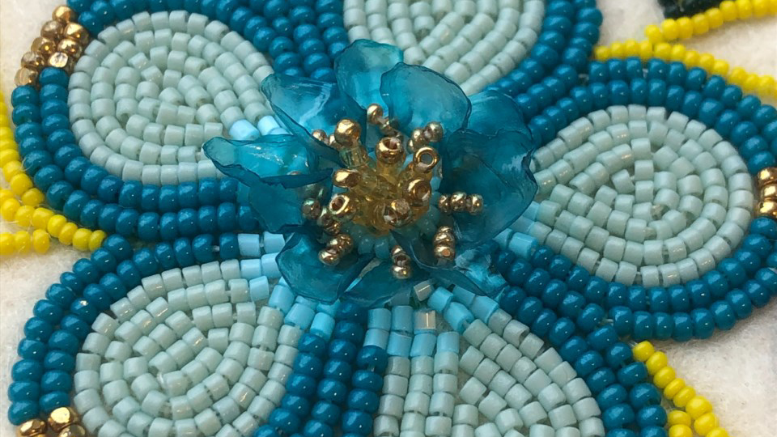
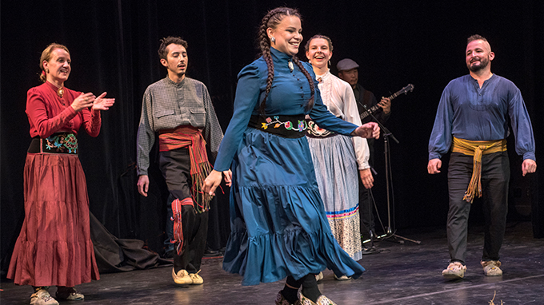
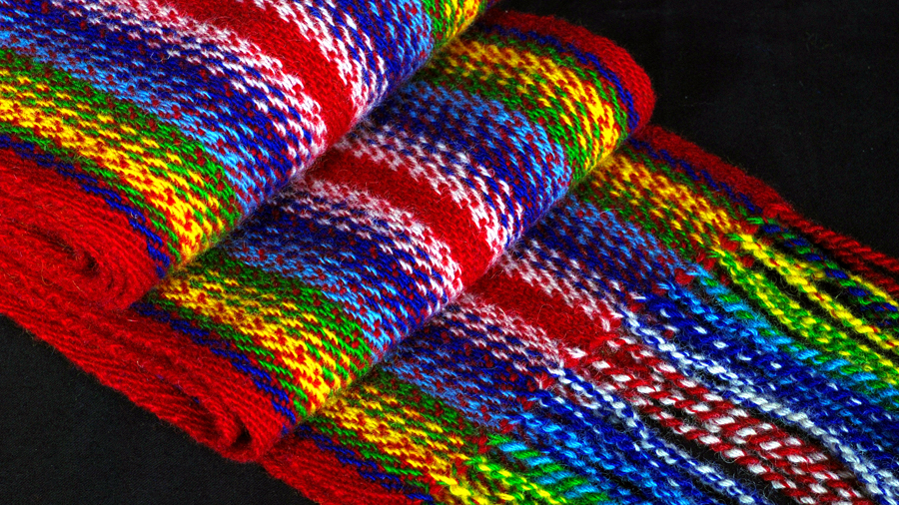
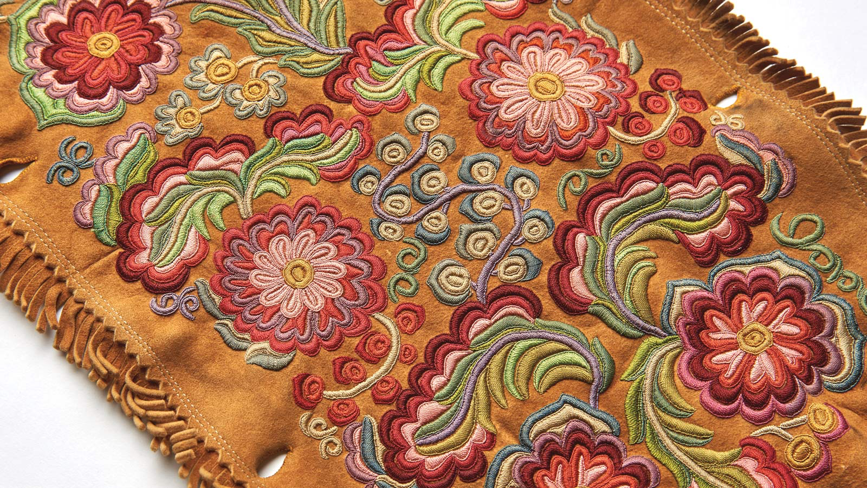
Cultures
Clothing, Arts, Dancing

Slide 11
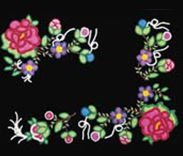
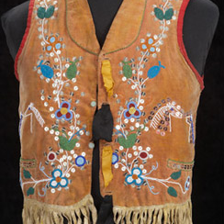
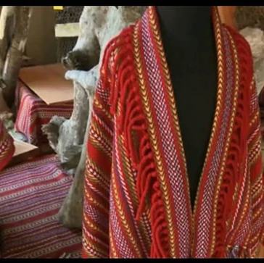
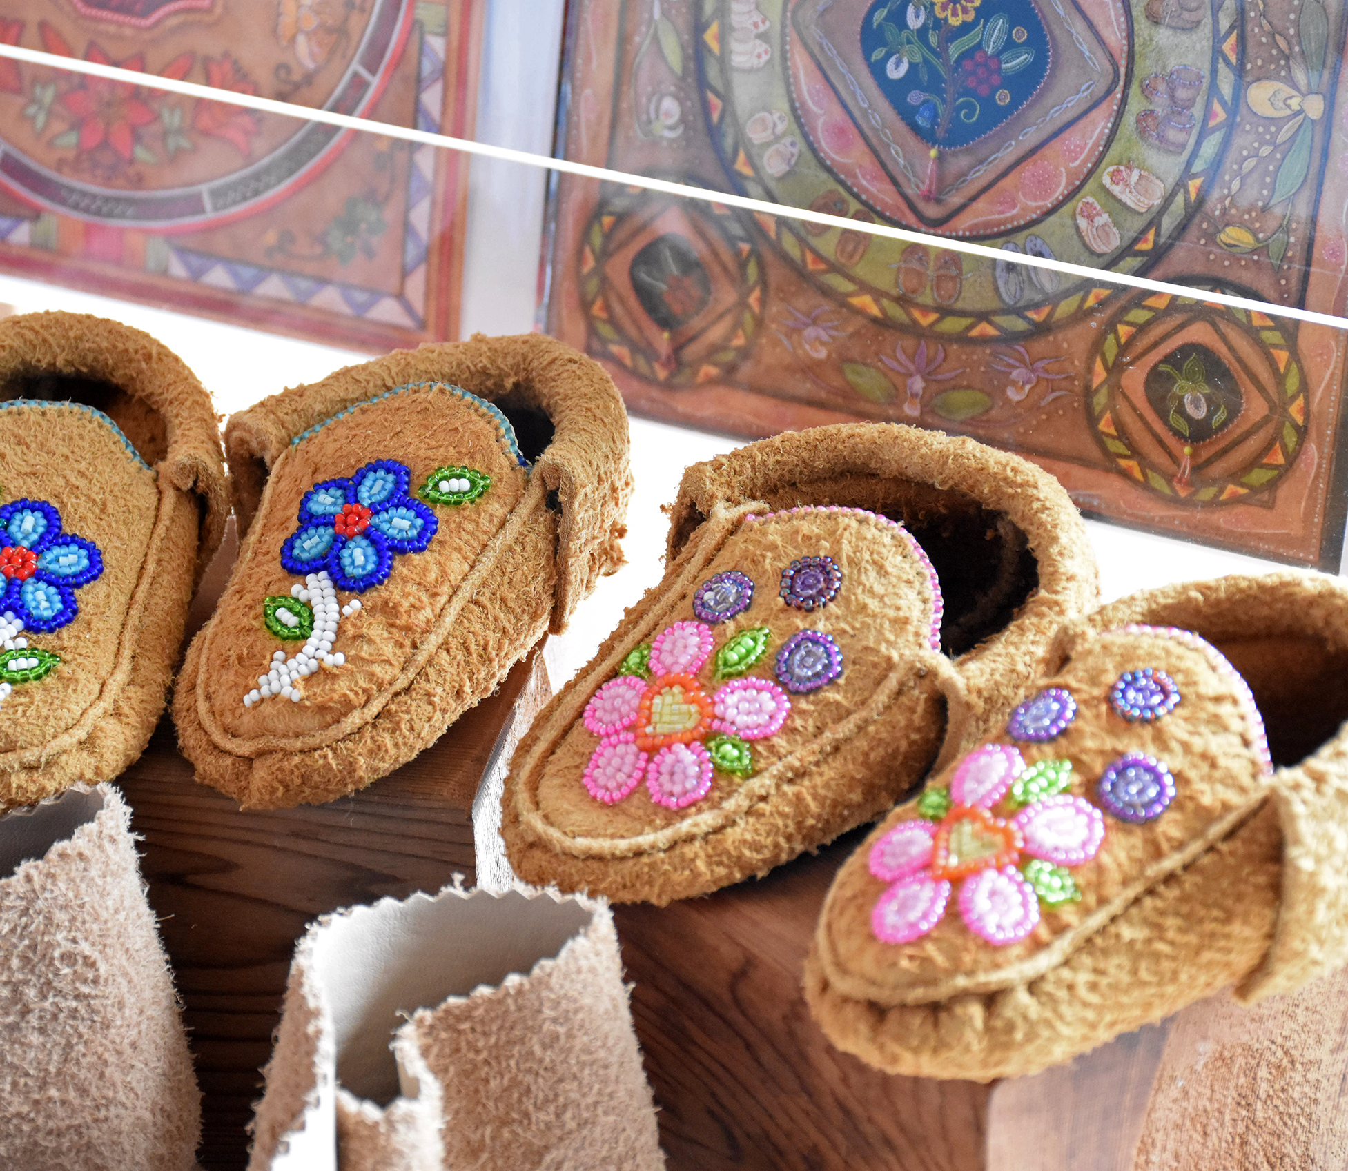
Clothing
Native and European styles.
《Women》
Simple dresses with high necklines.
Shawls, moccasins.
《Men》
Short shirt, red woolen cap, deerskin pants moccasins, long hooded coat.

Slide 12
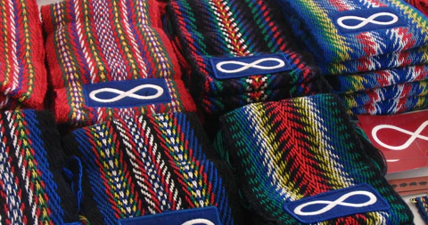
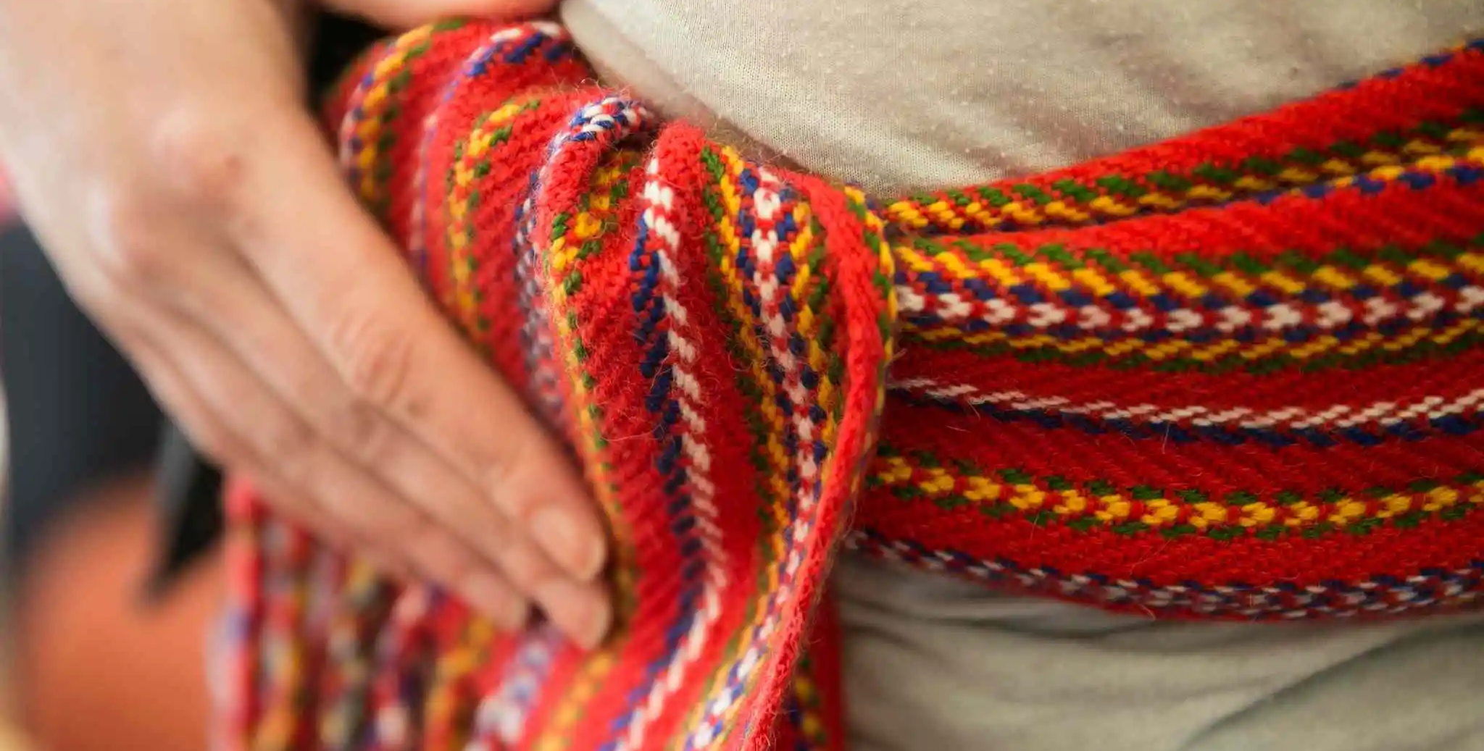
Sash
It wears around men’s waist.
It can use many ways.
Some types of color.

Slide 13
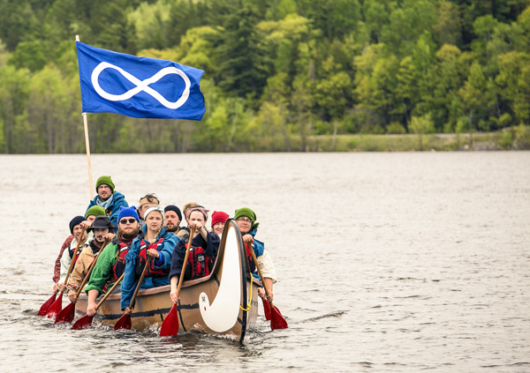
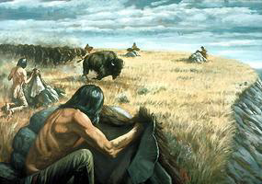
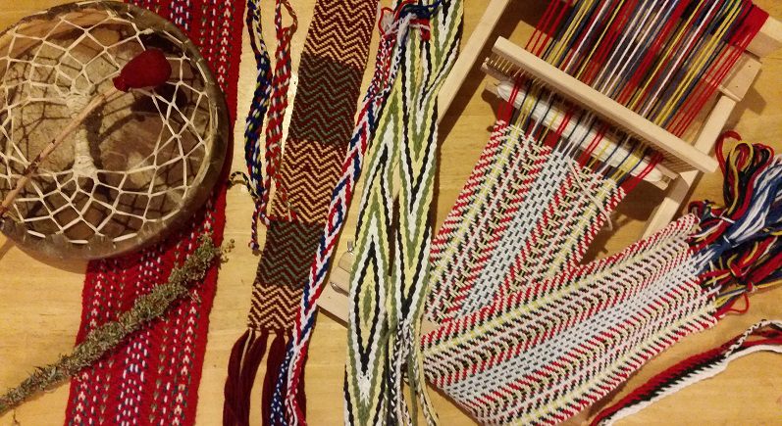
Art
《Traditional arts》
By hand making
Traditional hunting, Builder, Moccasins, Race, etc.
《Crafters》
﻿﻿To either supplement one's income or create one-of-a-kid gift for family and friend.
﻿﻿Beadwork, Glass blowing,
Weaving, etc.

Slide 14
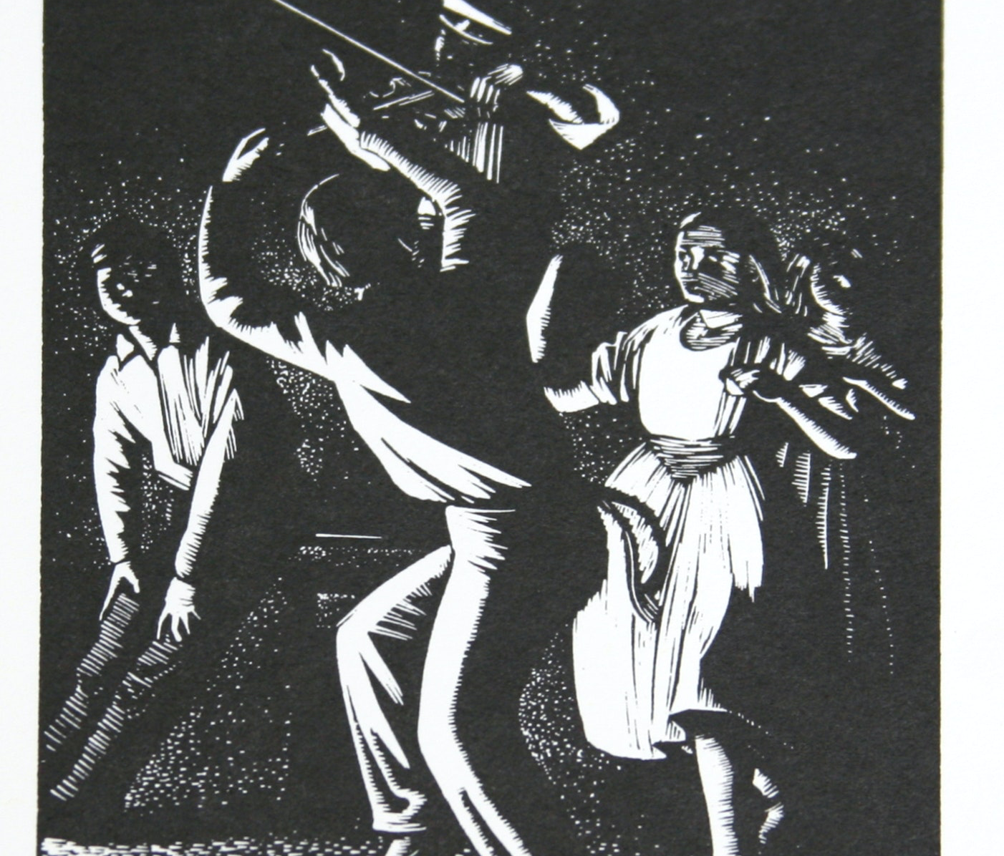
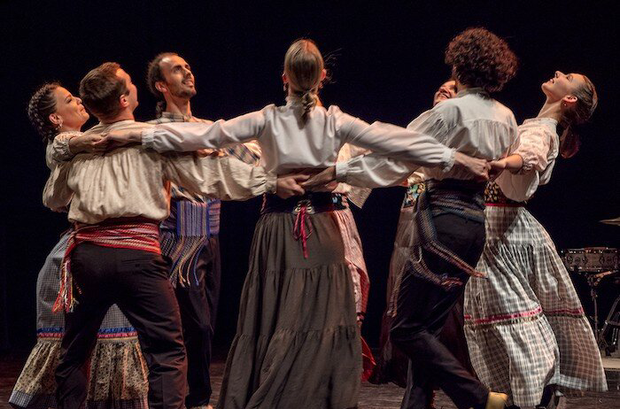
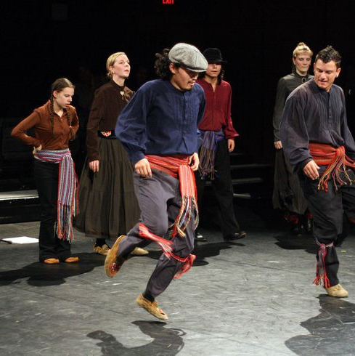
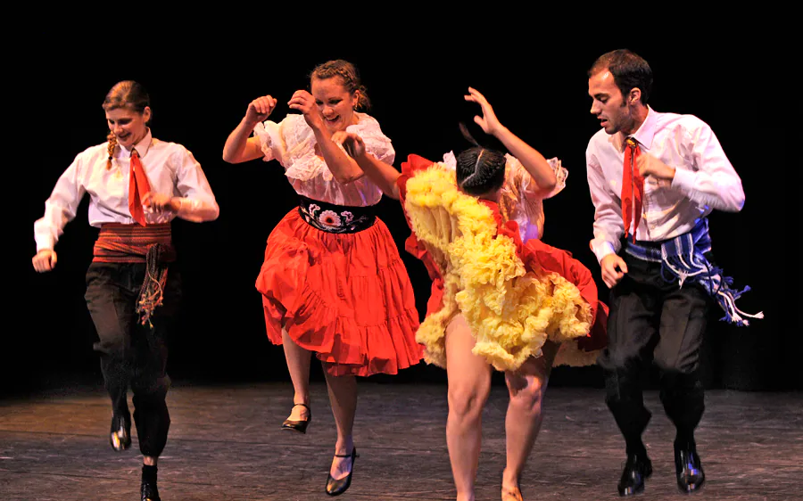
Dancing
Métis loves song and music.
They mix first nations and European ancestral cultures into unique fiddle playing and dance styles.
【Red river jig】
First nation’s dance.
It is step dance from Scotland and French Canadian, some steps.

Slide 15
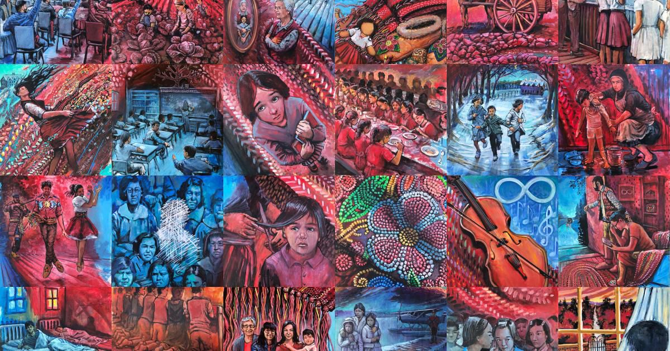
Conclusion
The power of unity and mind strongly.
They are gorgeous.
It is advantage for Métis to adopt other cultures and countries.

